Slide 1
Choriogonadotropin Alfa Infertility Clinical Trial
Effects of Choriogonadotropin Alfa on women undergoing controlled ovarian stimulation
By Daniel Benson

Slide 2
About The Trial
Main Objective: analyze the efficacy and safety of medical use of FE 999302 (Choriogonadotropin Alfa) against placebo users of women undergoing Controlled Ovarian Stimulation (COS)
Time range: 3 – 3.5 years (the trial ran from 2017 – 2020)
Participants: Adult women with tubal pregnancy or unexplained infertility
Trial allocation: randomised, double-blind, placebo-controlled, parallel-group, dose-range

Slide 3
About The Trial
Experimental group given FE 999302 as add-on treatment to follitropin delta; control group given placebo plus follitropin delta
Experimental group separated into 5 groups based on the FE 999302 dosage:
1 microgram
2 micrograms
4 micrograms
8 micrograms
12 micrograms

Slide 4
About The Drug
Choriogonadotropin Alfa: Used to help treat infertility issues by helping regulate the hormone hCG, which causes growth and release of mature eggs (ovulation).
Used in conjunction with follitropin delta, a drug that regulates the hormone FSH for egg production
Source: WebMD. Choriogonadotropin Alfa,Humrec Solution, Reconstituted (Recon Soln) - Uses, Side Effects, and More. Pulled on 10/23/2022 from https://www.webmd.com/drugs/2/drug-20305-3017/choriogonadotropin-alfa-human-recombinant-subcutaneous/choriogonadotropin-alfa-injection/details

Slide 5
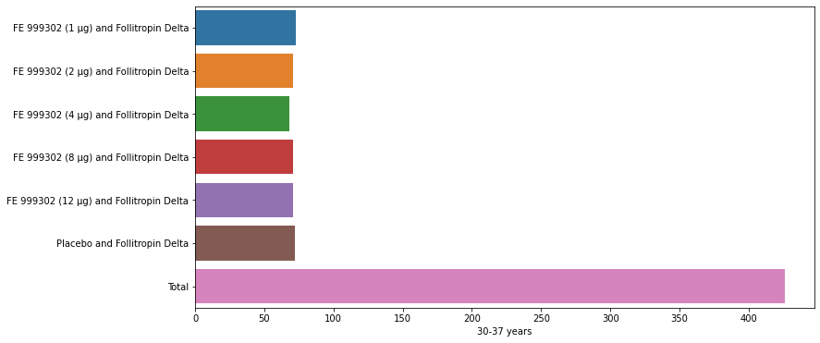
Demographics – Age

Slide 6

Demographics – Age Cont.

Slide 7
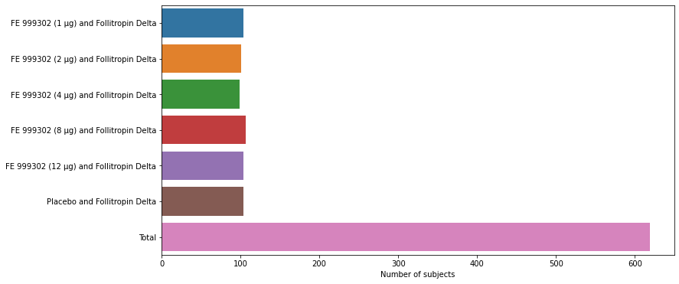
Demographics – Number Subjects

Slide 8
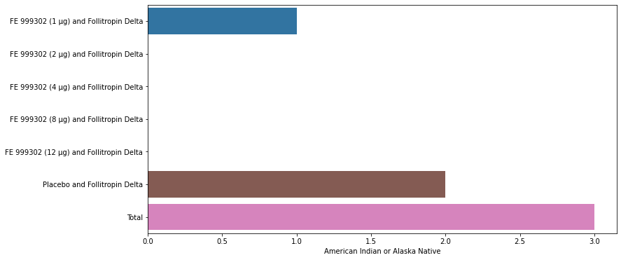
Demographics Cont.

Slide 9
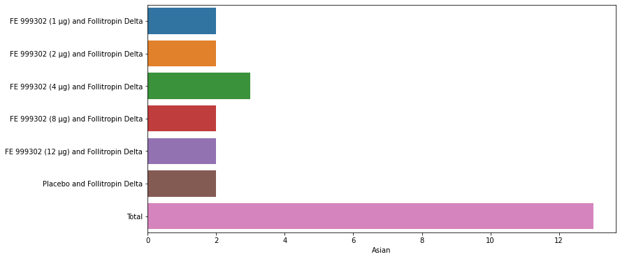
Demographics Cont.

Slide 10
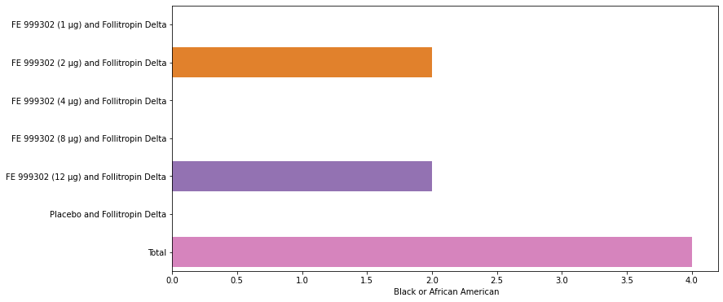
Demographics Cont.

Slide 11
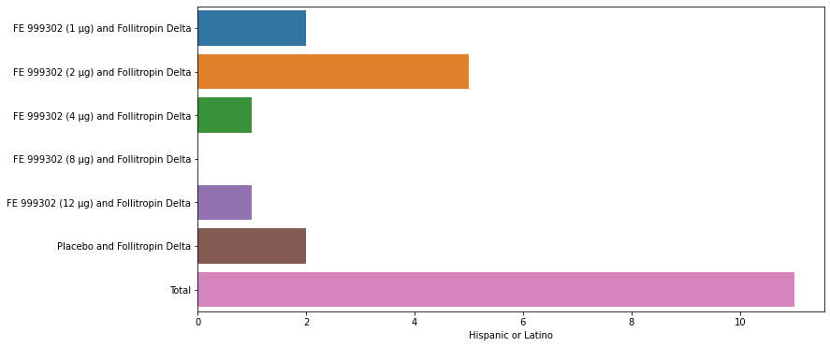
Demographics Cont.

Slide 12
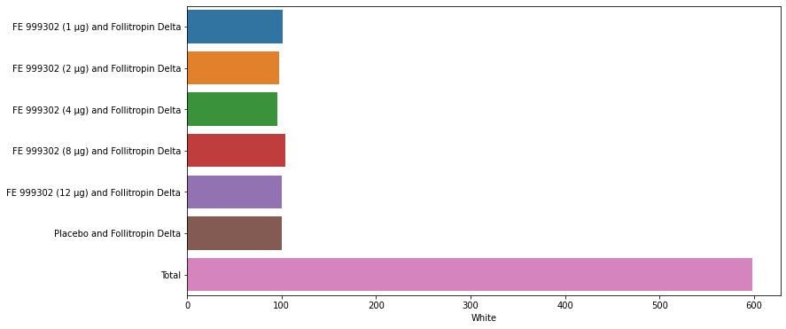
Demographics Cont.

Slide 13
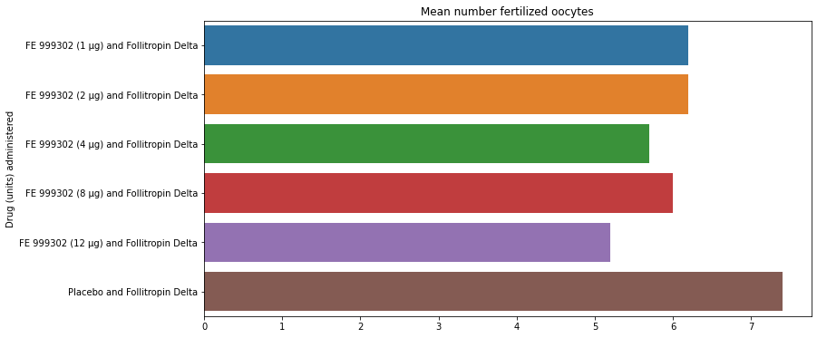
Results – Fertilized Oocytes by drug dose

Slide 14
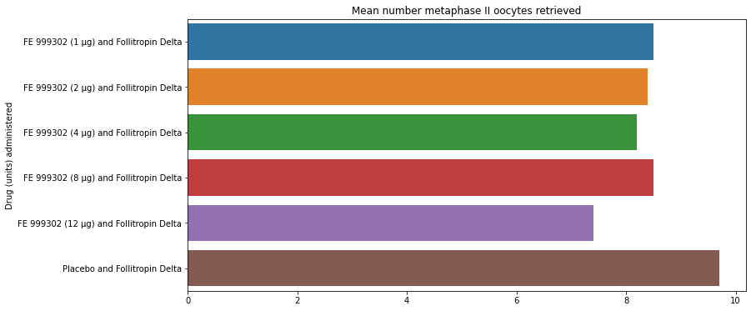
Results – Metaphase II Oocytes by Drug Dose

Slide 15
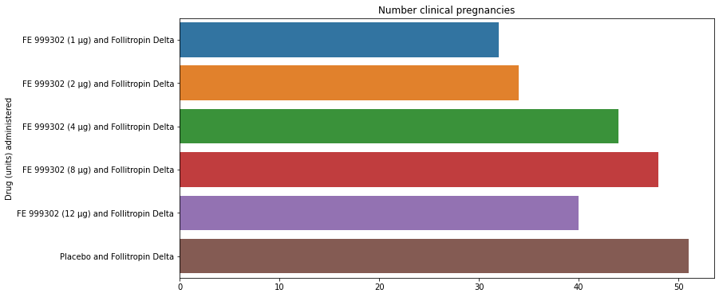
Results – Clinical Pregnancies by Drug Dose

Slide 16
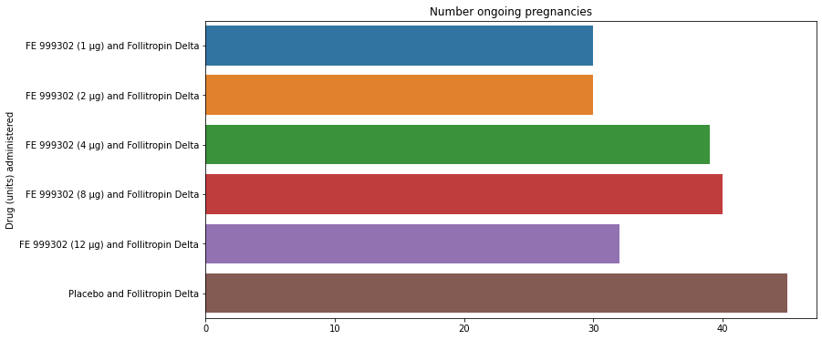
Results – Ongoing Pregnancies by Drug Dose

Slide 17
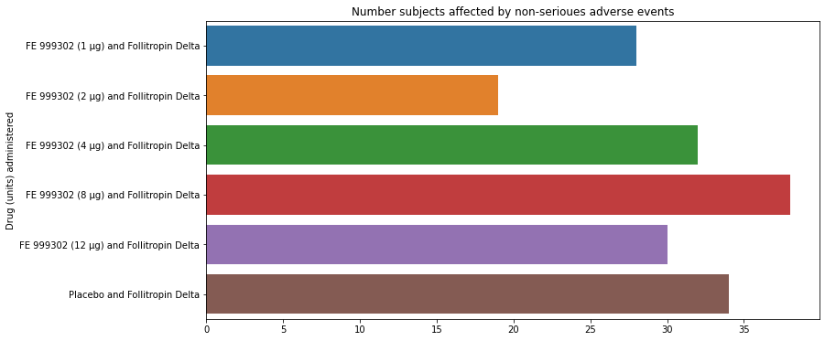
Results – Adverse Events

Slide 18
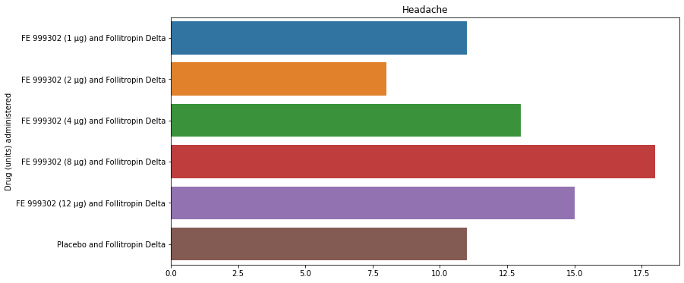
Results – Headache Side Effects

Slide 19
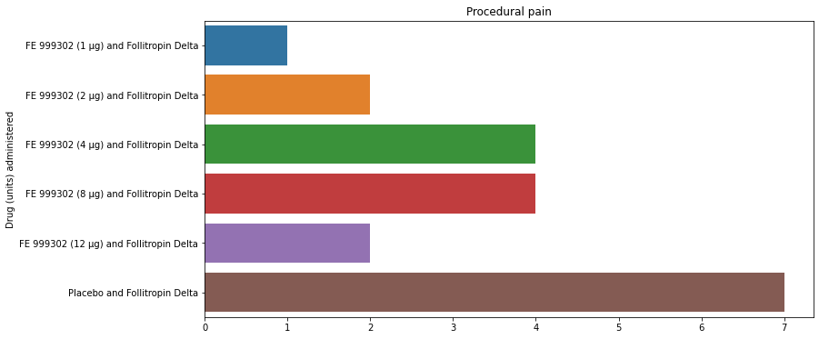
Results – Procedural Pain

Slide 20
Conclusion
Data suggests that the use of Choriogonadotropin Alfa does not have a major impact on oocyte development, egg health, or chances of pregnancies.
Choriogonadotropin Alfa does show a slight decrease in adverse effects compared to the control group, except for the 8 micro-gram sub-group
Choriogonadotropin Alfa did seem to cause an in crease in the number of headaches experienced overall, and a decrease in procedural pain
Of the experimental group, the 8 micro-gram Choriogonadotropin group showed the best long-term results in the form of clinical pregnancies and ongoing pregnancies

Slide 21
Sources
Ferring Pharmaceuticals A/S. Jan 30, 2020. A randomised, double-blind, placebo-controlled, parallel-group, dose-range trial to investigate the efficacy and safety of FE 999302 as add-on treatment to follitropin delta (REKOVELLE) in women undergoing controlled ovarian stimulation in a long GnRH agonist protocol. EU Clinical Trials Register. Pulled on 10/28/2022 from https://www.clinicaltrialsregister.eu/ctr-search/trial/2017-003810-13/results#trialInformationSection
WebMD. Choriogonadotropin Alfa,Humrec Solution, Reconstituted (Recon Soln) - Uses, Side Effects, and More. Pulled on 10/23/2022 from https://www.webmd.com/drugs/2/drug-20305-3017/choriogonadotropin-alfa-human-recombinant-subcutaneous/choriogonadotropin-alfa-injection/details

